Slide 1


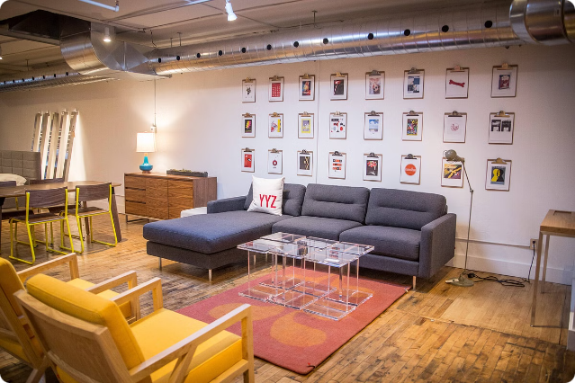
Sales Forecasting for Furniture Store
This presentation outlines a comprehensive approach to furniture sales using machine learning. We'll explore data cleaning, EDA, Model selection, Model Building and prediction results. This information can empower informed business decisions and drive future growth.
by Akash Gade
AG

Slide 2
Objective
To develop a Machine Learning Model that accurately forecasts future sales for a furniture store based on historical data.
Developed Machine Learning Model can help the store in inventory management, marketing strategies and financial planning.

Slide 3
Data Overview
Data is imported using Pandas library. The dataset comprises 2,121 rows and 21 columns, encompassing order details, customer information and sales data.
Data Cleaning and EDA
Data cleaning involved removing duplicates and handling missing values. Feature extraction generated new features like Order Year, Order Month, Shipping Year and Shipping Month to enhance analysis and model training.

Slide 4

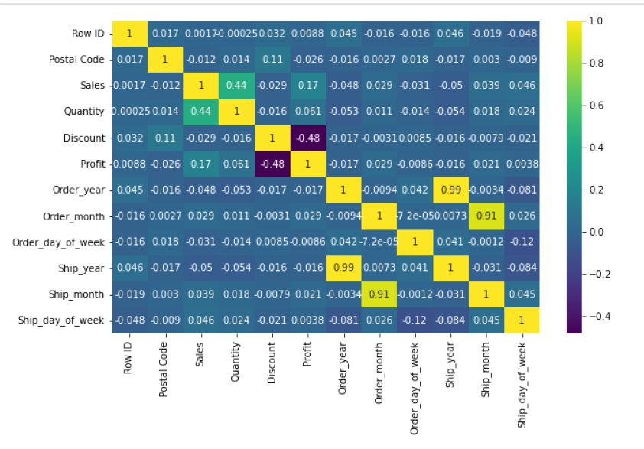
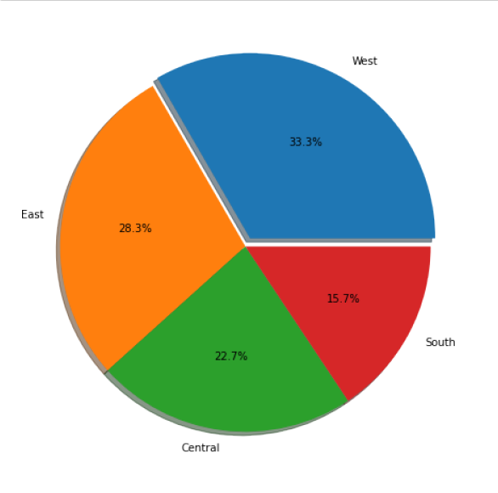
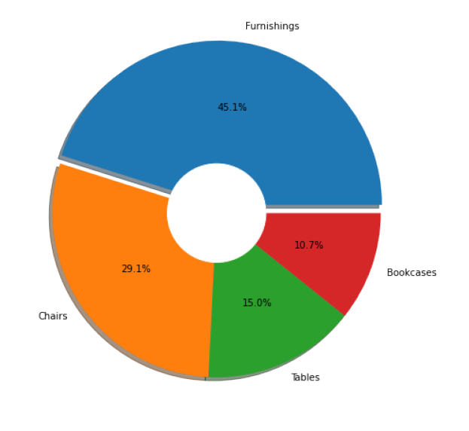
=n ss
Correlations by Heatmap
Correlations and Insights
1
Sales and Quantity
A strong positive correlation exists between Sales and Quantity, indicating that higher sales volumes are driven by larger quantities sold.
2
Discount and Profit
A negative correlation exists between Discount and Profit. Higher discounts lead to lower profits, despite higher sales quantities.
3
Sub-category and Region
The sub-category ‘ Furnishings ’ holds the highest share in sales, accounting for 45.1% of the total. Highest sale found to be in ‘ West ’ region holding 33.3% share of the total sales distribution across all regions.
Sub-category
Region

Slide 5

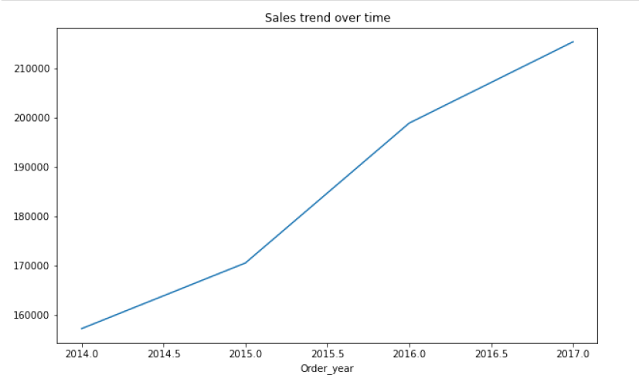
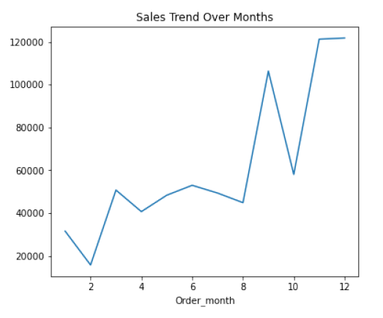
Time Series Analysis
1
Yearly Trend
Sales have exhibited an upward trend over year, suggesting growth in the furniture market and increasing customer demand.
2
Monthly Trend
The data reveals seasonal peaks, with higher sales during specific months. Understanding these patterns enables forecasting future demand and optimizing inventory levels.
3
Seasonality and Holidays
Sales often spike around major holidays, such as Christmas and Thanksgiving. These trends can be incorporated into forecasting models to improve accuracy.

Slide 6

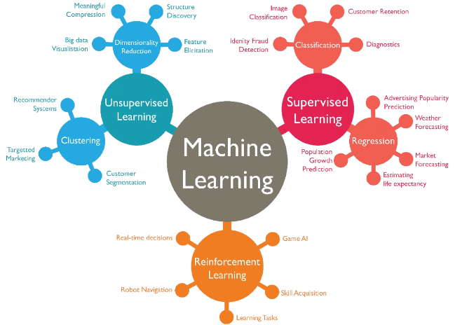
Model Selection
Linear Regression
This model assumes a linear relationship between features and the target variable, providing a simple baseline prediction.
Decision Tree Regressor
This model can capture non-linear patterns in the data, potentially leading to more accurate predictions than linear regression.
Random Forest Regressor
This ensemble model combines multiple decision trees to improve prediction accuracy and reduce overfitting, often achieving superior performance.

Slide 7


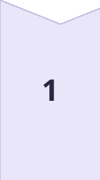
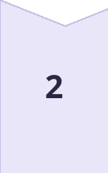
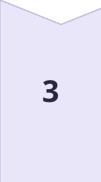
Model Performance & Accuracy
Model Performance
Among the tested models, the Random Forest Regressor demonstrated the highest accuracy based on the Mean Squared Error (MSE) and R-squared (R²) metrics.
Prediction Accuracy
Random Forest Model accurately predicted future sales trends, providing valuable insights into future demand and market dynamics.
Model Optimization
Grid Search CV is applied to optimize Random Forest Model parameters for better performance.

Slide 8
Conclusion
The sales trend shows consistent growth over the years, with certain months indicating seasonal peaks.
Key factors like quantity sold and discounts influence sales, though discounts may reduce profit margins.
Random Forest Regressor effectively captures non-linear relationships, outperforming simpler models like Linear Regression.
This analysis helps in improving inventory management and sales strategies.
Business Recommendations:
Adjust inventory to align with peak demand and optimize discount strategies to boost sales while maintaining profits.
Continuously update the model to enhance accuracy and adapt to changing market conditions.

Slide 9
THANK YOU

